Slide 1
CS473-Algorithms I
Lecture X
Dynamic Tables

Slide 2
Why Dynamic Tables?
In some applications:
We don't know how many objects will be stored in a table.
We may allocate space for a table
  But, later we may find out that it is not enough.
  Then, the table must be reallocated with a larger size.
    All the objects stored in the original table
    Must be copied over into the new table.

Slide 3
Why Dynamic Tables?
Similarly, if many objects are deleted from the table:
  it may be worthwhile to reallocate the table with a smaller size.
This problem is called
Dynamically Expanding and Contracting a table.

Slide 4
Why Dynamic Tables?
Using amortized analysis we will show that,
The amortized cost of insertion and deletion is O(1).
Even though the actual cost of an operation is large when it triggers an expansion or a contraction.
We will also show how to guarantee that
The unused space in a dynamic table never exceeds a constant fraction of the total space.

Slide 5
Operations
TABLE-INSERT:
Inserts into the table an item that occupies a single slot.
TABLE-DELETE:
Removes an item from the table & frees its slot.

Slide 6
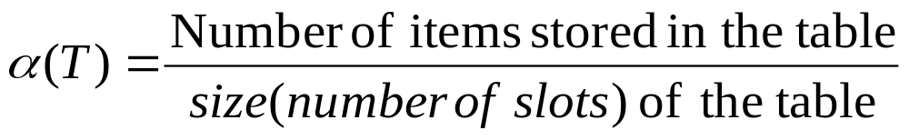
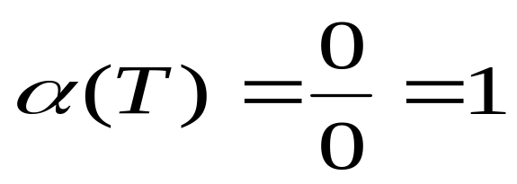
Load Factor
Load Factor of a Dynamic Table T
For an empty table
by definition

Slide 7
Insertion-Only Dynamic Tables
Table-Expansion:
Assumption:
  Table is allocated as an array of slots
A table fills up when
  all slots have been used
  equivalently, when its load factor becomes 1
Table-Expansion occurs when
  An item is to be inserted into a full table

Slide 8
Insertion-Only Dynamic Tables
A Common Heuristic
  Allocate a new table that has twice as many slots as the old one.
Hence, insertions are performed if only
1 / 2 ≤ α(T) ≤ 1

Slide 9
Table Insert
TABLE-INSERT (T, x)
if size[T] = 0 then
allocate table[T] with 1 slot
size[T] ← 1
if num[T] = size[T] then
allocate new-table with 2.size[T] slots
copy all items in table[T] into new-table
free table[T]
table[T] ← new-table[T]
size[T] ← 2.size[T]
insert x into table[T]
num[T] ← num[T] + 1
end
table[T] : pointer to block of table storage
num[T] : number of items in the table
size[T] : total number of slots in the table
Initially, table is empty, so num[T] = size[T] = 0

Slide 10
Table Expansion
Running time of TABLE-INSERT is proportional to the number of elementary insert operations.
Assign a cost of 1 to each elementary insertion
Analyze a sequence of n TABLE-INSERT operations on an initially empty table

Slide 11
Cost of Table Expansion
What is cost c_{i} of the i-th operation?
If there is room in the current table (or this is the first operation)
  c_{i} = 1 (only one elementary insert operation)
If the current table is full, an expansion occurs, then the cost is c_{i} = i.
  1 for the elementary insertion of the new item
  i-1 for the items that must be copied from the old table to the new table.

Slide 12
Cost of Table Expansion
If n operations are performed,
  The worst case cost of an operation is O(n)
  Therefore the total running time is O(n²)
This bound is not tight, because
  Expansion does not occur so often in the course of n operations.

Slide 13
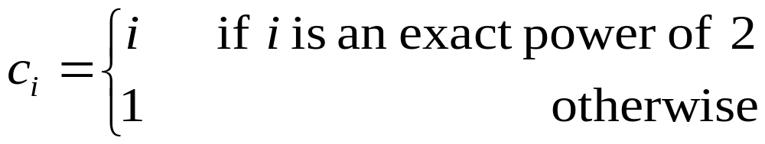
Amortized Analysis of Insert
  The Aggregate Method
Table is initially empty.
Observe:
  i-th operation causes an expansion only when i-1 is a power of 2.

Slide 14
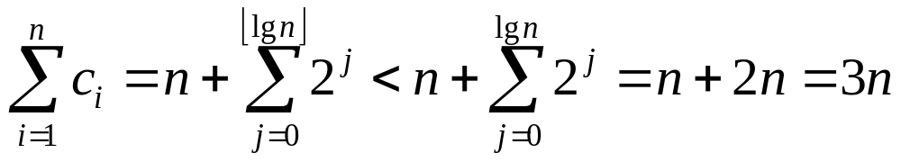
The Aggregate Method
Therefore the total cost of n TABLE-INSERT operations is
The amortized cost of a single operation is 3n/n=3 = O(1)
i | 1 | 2 | 3 | 4 | 5 | 6 | 7 | 8 | 9 | 10 | 11 | 12 | 13 | 14 | 15 | 16 | 17 | 18 | 19 | 20 | ...
c_{i} | 1 | 2 | 3 | 1 | 5 | 1 | 1 | 1 | 9 | 1 | 1 | 1 | 1 | 1 | 1 | 1 | 17 | 1 | 1 | 1 | ...
 | 1 | 1 | 1 | 1 | 1 | 1 | 1 | 1 | 1 | 1 | 1 | 1 | 1 | 1 | 1 | 1 | 1 | 1 | 1 | 1 | ...
Expansion cost |  | 1 | 2 |  | 4 |  |  |  | 8 |  |  |  |  |  |  |  | 16

Slide 15
The Accounting Method
Assign the following amortized costs
  Table-Expansion : 0
  Insertion of a new item : 3
Insertion of a new item
  1 (as an actual cost) for inserting itself into the table
  1 (as a credit) for moving itself in the next expansion
  1 (as a credit) for moving another item (in the next expansion) that has already moved in the last expansion

Slide 16
Accounting Method Example
Size of the table: M
Immediately after an expansion (just before the insertion)
num[T] = M/2 and size[T] = M where M is a power of 2.
Table contains no credits
.
1 | 2 | 3 | 4 | 5 | 6 | 7 | 8 | 9 | 10 | 11 | 12 | 13 | 14 | 15 | 16
X | X | X | X | X | X | X | X

Slide 17
Accounting Method Example
1st insertion
2nd insertion
1 | 2 | 3 | 4 | 5 | 6 | 7 | 8 | 9 | 10 | 11 | 12 | 13 | 14 | 15 | 16
X | X | X | X | X | X | X | X | Z
$1 |  |  |  |  |  |  |  | $1
(c)
(a) $1 for insertion
(b)
1 | 2 | 3 | 4 | 5 | 6 | 7 | 8 | 9 | 10 | 11 | 12 | 13 | 14 | 15 | 16
X | X | X | X | X | X | X | X | Z | Z
$1 | $1 |  |  |  |  |  |  | $1 | $1

Slide 18
Accounting Method Example
M/2th Insertion
Thus, by the time the table contains M items and is full
  each item in the table has $1 of credit to pay for its move during the next expansion
1 | 2 | 3 | 4 | 5 | 6 | 7 | 8 | 9 | 10 | 11 | 12 | 13 | 14 | 15 | 16
X | X | X | X | X | X | X | X | Z | Z | Z | Z | Z | Z | Z | Z
$1 | $1 | $1 | $1 | $1 | $1 | $1 | $1 | $1 | $1 | $1 | $1 | $1 | $1 | $1 | $1

Slide 19
The Potential Method
Define a potential function Φ that is
  0 immediately after an expansion
  builds to the table size by the time table becomes full
Next expansion can be paid for by the potential.

Slide 20
Definition of Φ
One possible Φ is:
Φ(T) = 2*num[T] –size[T]
Immediately after an expansion
size[T] = 2*num[T] ⇒ Φ(T) = 0
Immediately before an expansion
size[T] = num[T] ⇒ Φ(T) = num[T]
The initial value for the potential is 0

Slide 21
Definition of Φ
Since the table is at least half full
(i.e. num[T] ≥ size[T] / 2)
Φ(T) is always nonnegative.
Thus, the sum of the amortized cost of n TABLE-INSERT operations is an upper bound on the sum of the actual costs.

Slide 22
Analysis of i-th Table Insert
n_{i} : num[T] after the i-th operation
s_{i} : size[T] after the i-th operation
Φ_{i} : Potential after the i-th operation
Initially we have n_{i} = s_{i} = Φ_{i} = 0
Note that, n_{i} = n_{i-1} +1 always hold.

Slide 23
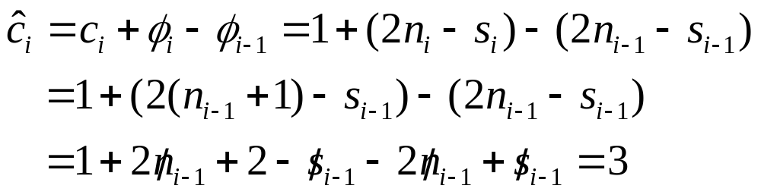
Insert without Expansion
If the i-th TABLE-INSERT does not trigger an expansion,
s_{i} = s_{i – 1} ; c_{i} = 1

Slide 24
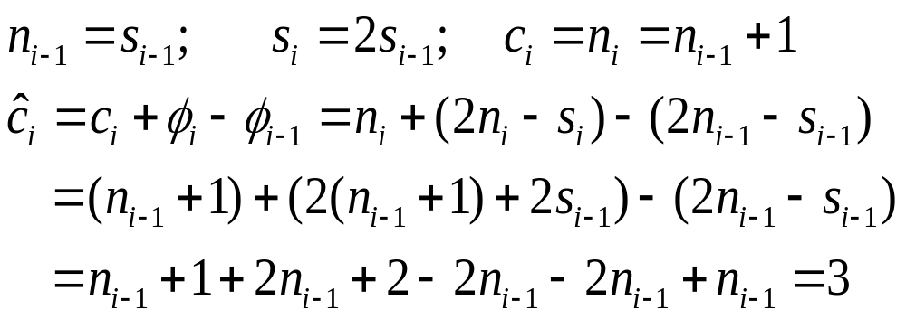
Insert with Expansion
If the i-th TABLE-INSERT does trigger an expansion, then

Slide 25
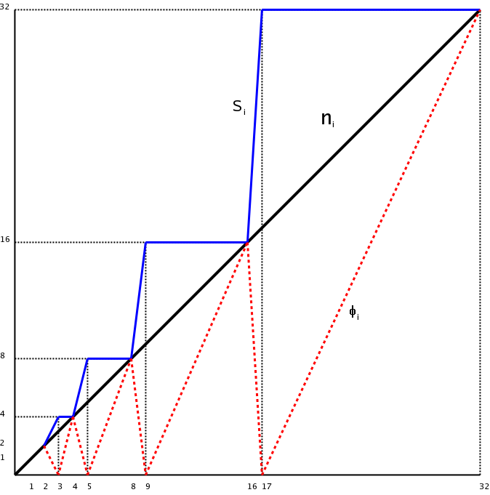

Slide 26
Adding Delete Operation
TABLE-DELETE: Remove the specified item from the table. It is often desirable to contract the table.
In table contraction, we would like to preserve two properties
Load factor of dynamic table is bounded below by a constant
Amortized cost of a table operation is bounded above by a constant
We assume that the cost can be measured in terms of
elementary insertions and deletions

Slide 27

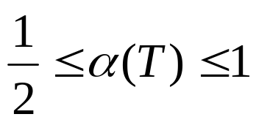
Expansion and Contraction
A natural strategy for expansion and contraction
Double the table size when an item is inserted into a full table
Halve the size when a deletion would cause < 1 / 2
This strategy guarantees
Unfortunately, it can cause the amortized cost of an operation to be quite large

Slide 28
Worst-Case for α(T) ≥ ½
Consider the following worst case scenario
  We perform n operations on an empty table where n is a power of 2
  First n/2 operations are all insertions , cost a total of Θ(n)
    at the end: we have num[T] = size[T] = n/2
  Second n/2 operations repeat the sequence
    I D D I
    that is I D D I I D D I I D D I ...

Slide 29
Worst-Case for α(T) ≥ ½
Example: n=16
i: | 1 | 2 | ... | 7 | 8 | 9 | 10 | 11 | 12 | 13 | 14 | 15 | 16
oper: | I | I | ... | I | I | I | D | D | I | I | D | D | I
n_{i} | 1 | 2 | ... | 7 | 8 | 9 | 8 | 7 | 8 | 9 | 8 | 7 | 8
s_{i} | 1 | 2 | ... | 8 | 8 | 16 | 16 | 8 | 8 | 16 | 16 | 8 | 8
 |  |  |  |  |  | E |  | C |  | E |  | C
In the second n/2 operations
  The first INSERT cause an expansion
  Two further DELETEs cause contraction
  Two further INSERTs cause expansion ... and so on
Hence there are n/8 expansions and n/8 contractions
The cost of each expansion and contraction is ≈ n/2

Slide 30
Worst-Case for α(T) ≥ ½
Thus the total cost of n operations is Θ(n²) since
  First n/2 operations : 3n
  Second n/2 operations : (n/4)*(n/2)=n²/8
The amortized cost of an operation is Θ(n)
The difficulty with this strategy is
  After an expansion, we do not perform enough deletions to pay for a contraction
  After a contraction, we do not perform enough insertions to pay for an expansion

Slide 31
Improving Expansion – Contraction
We can improve upon this strategy by allowing α(T) to drop below ½
We continue to double the table size when an item is inserted into a full table
But, we halve the table size (perform contraction)
when a deletion causes α(T) < ¼ rather than α(T) < ½ ,
Therefore, ¼ ≤ α(T) ≤ 1

Slide 32
Improving Expansion – Contraction
Hence after an expansion, α(T) = ½ , thus at least half of the items in the table must be deleted before a contraction can occur.
Similarly, after a contraction α(T) = ½ , thus the number of items in the table must be doubled by insertions before an expansion can occur.

Slide 33
Potential Method
Define the potential function as follows
Φ(T) = 0 immediately after an expansion or contraction
Recall that, α(T) = ½ immediately after and expansion or contraction,
  therefore the potential should build up to num[T]
  as α(T) increases to 1 or decreases to ¼
So that the next expansion or contraction can be paid by the potential.

Slide 34
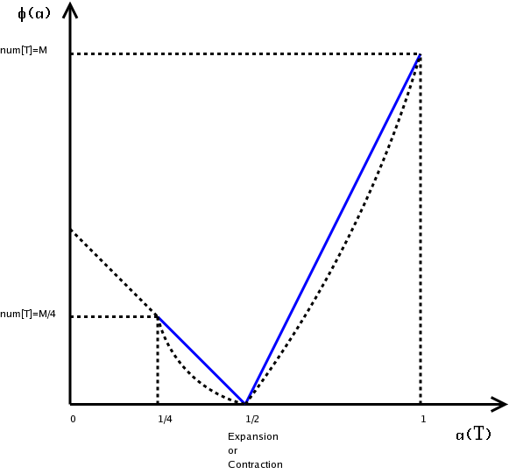
Φ(α) w.r.t. α(T)
M=num[T] when an expansion or contraction occurs

Slide 35
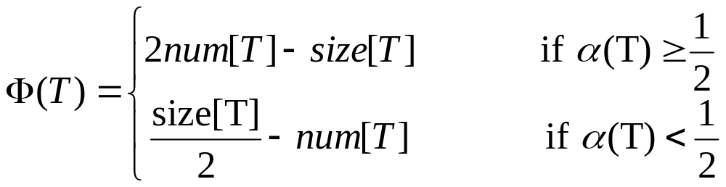
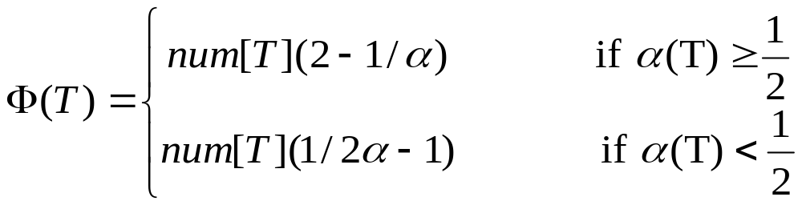
Description of New Φ
One such Φ is
or

Slide 36
Description of New Φ
Φ = 0 when α = ½
Φ = num[T] when α = ¼
Φ = 0 for an empty table
(num[T] = size[T]=0, α[T] = 0)
Φ is always nonnegative

Slide 37
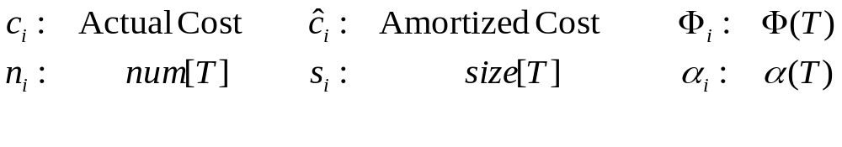
Amortized Analysis
Operations are:
  TABLE-INSERT
  TABLE-DELETE
after the i-th operation

Slide 38
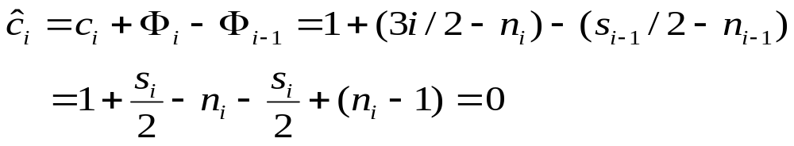
Table Insert
n_{i}=n_{i-1} + 1 ⇒ n_{i-1} = n_{i} – 1
Table contraction may not occur.
α_{i-1} ≥ ½
  Analysis is identical to that for table expansion
  Therefore, ĉ_{i} = 3 whether the table expands or not.
α_{i-1} < ½ and α_{i} < ½
  Expansion may not occur (ĉ_{i} = 1 , s_{i} = s_{i-1} )

Slide 39
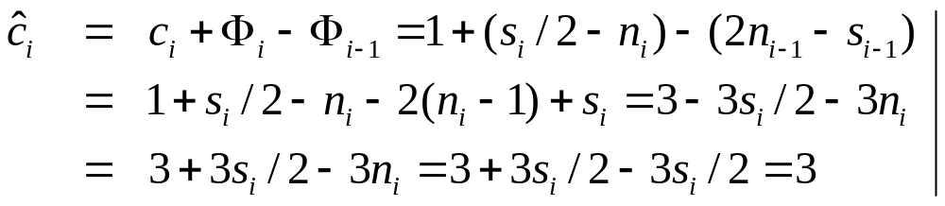
Table Insert
α_{i-1} < ½ and α_{i} ≥ ½
⇒ α_{i} = ½
Expansion may not occur (c_{i} = 1 ; s_{i} = s_{i-1} ; n_{i} = s_{i} / 2)
Thus, amortized cost of a TABLE-INSERT operation is at most 3.

Slide 40
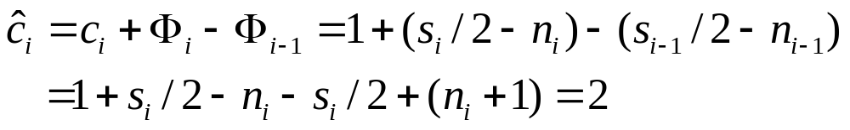
Table Delete
n_{i}=n_{i-1} - 1 ⇒ n_{i-1} = n_{i} + 1
Table expansion may not occur.
α_{i-1} ≤ ½ and ¼ ≤ α_{i} < ½ (It does not trigger a contraction)
s_{i} = s_{i-1} and c_{i} = 1 and α_{i} < ½

Slide 41
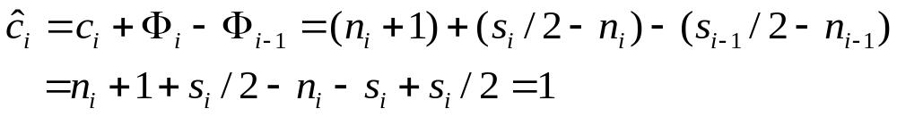
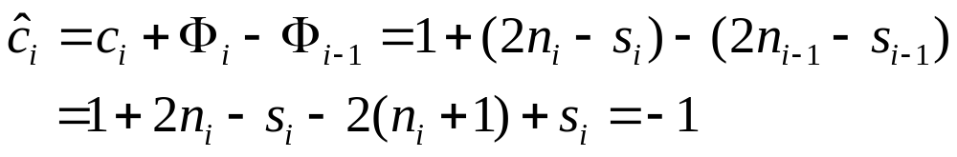
Table Delete
α_{i-1} = ¼ (It does trigger a contraction)
s_{i} = s_{i-1}/2 ; n_{i} = s_{i-1}/2; and c_{i} = n_{i} +1
α_{i-1} > ½ (α_{i} ≥ ½ )
Contraction may not occur (c_{i}=1 ; s_{i} = s_{i-1})

Slide 42
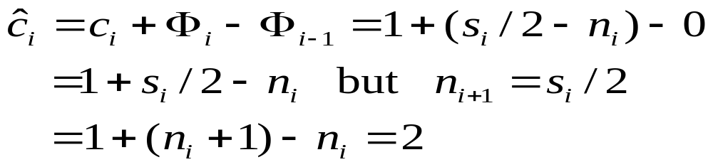
Table Delete
α_{i-1} = ½ (α_{i} < ½)
Contraction may not occur
c_{i} = 1 ; s_{i} = s_{i-1} ; n_{i} = s_{i-1}/2; and Φ_{i-1}=0)

Slide 43
Table Delete
Thus, the amortized cost of a TABLE-DELETE operation is at most 2
Since the amortized cost of each operation is bounded above by a constant
The actual time for any sequence of n operations on a Dynamic Table is O(n)

